Slide 1
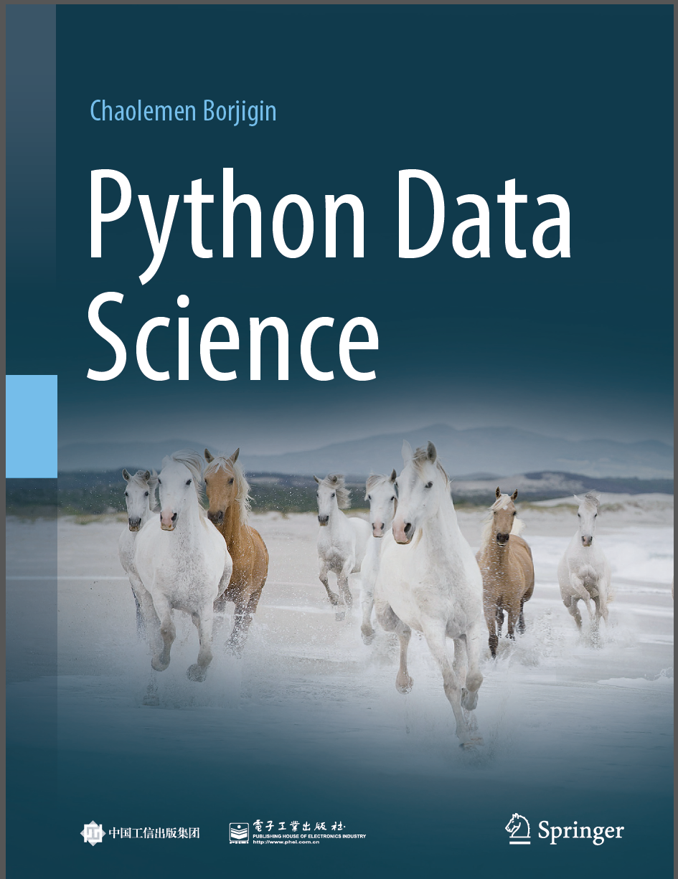
Python Data Science
Chaolemen Borjigin
Renmin University of China
chaolemen@ruc.edu.cn

Slide 2
3.5 Exception and errors
▼ Chapter 3 Advanced Python Programming for Data Science
► 3.5 Exception and errors
Chaolemen Borjigin
Renmin University of China
chaolemen@ruc.edu.cn

Slide 3
Summary of this chapter
▼ Chapter 3 Advanced Python Programming for Data Science
► 3.5 Exception and errors
3.5.1 Try/Except/Finally
3.5.2 Exception reporting mode
3.5.3 Assertion

Slide 4
3.5.1 Try/Except/Finally
▼Chapter 3 Advanced Python Programming for Data Science
► 3.5 Exception and errors
In[1]:
try:
f=open('myfile.txt','w')
while True:
s=input("please enter Q")
if s.upper()=='Q':break
f.write(s+'\n')
except KeyboardInterrupt:
print("program interruption")
finally:
f.close()
Out[1]:
please enter Qa
please enter QQ

Slide 5
3.5.2 Exception reporting mode
▼Chapter 3 Advanced Python Programming for Data Science
► 3.5 Exception and errors
In[3]:
%xmode Plain
x=1
x1
Exception reporting mode: Plain
Traceback (most recent call last):
File "<ipython-input-14-6067cb69f3f6>", line 3, in <module>
x1
NameError: name 'x1' is not defined

Slide 6
3.5.2 Exception reporting mode
▼Chapter 3 Advanced Python Programming for Data Science
► 3.5 Exception and errors
In[4]:
%xmode Verbose
x=1
x1
Exception reporting mode: Verbose
--------------------------------------------------------------------------
NameError Traceback (most recent call last)
<ipython-input-15-9ace4a24824c> in <module>()
1 get_ipython().magic('xmode Verbose')
2 x=1
----> 3 x1
global x1 = undefined
NameError: name 'x1' is not defined

Slide 7
3.5.2 Exception reporting mode
▼Chapter 3 Advanced Python Programming for Data Science
► 3.5 Exception and errors
In[5]:
%xmode Context
x=1
x1
Exception reporting mode: Context
--------------------------------------------------------------------------
NameError Traceback (most recent call last)
<ipython-input-12-5d9d36673da7> in <module>()
1 get_ipython().magic('xmode Context')
2 x=1
----> 3 x1
NameError: name 'x1' is not defined

Slide 8
3.5.3 Assertion
▼Chapter 3 Advanced Python Programming for Data Science
► 3.5 Exception and errors
In[6]:
a=1
b=2
assert b!=0 , "The denominator can't equal 0"
In[7]:
a=1
b=0
assert b!=0 , "The denominator can't equal 0"
---------------------------------------------------------------------------
AssertionError Traceback (most recent call last)
<ipython-input-12-7df206de7943> in <module>
1 a=1
2 b=0
----> 3 assert b!=0 , "The denominator can't equal 0"
AssertionError: The denominator can't equal 0

Slide 9


